Slide 1
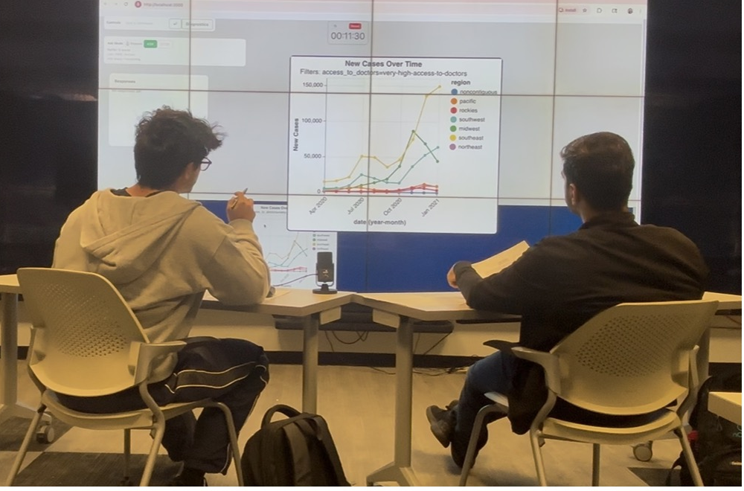

Collaborative Data Exploration Through Visualization: Analyzing Impact Of Conversational Assistants
Thanks to
Abari Bhattacharya
(her thesis – just defended on Apr 29, 2026)

Slide 2
Exploratory Data Analysis^{[1]}
Method for analyzing data predominantly using graphical techniques
Gain valuable insights into the information that can be gathered from the data
[1]John W. Tukey. Exploratory Data Analysis. Vol. 2. Reading, Mass: Addison-
Wesley, 1977.

Slide 3
Exploratory Data Analysis is a Collaborative Process
Multiple people work together to interpret data
Leverage the diverse perspectives
Enhance sense-making and discover insights
Traditional tools (Tableau , MS Excel , Plotly etc.) →designed typically for single user
Challenge for collaborative exploratory analysis of data through visualizations^{[3,4,5]}
[3]Petra Isenberg et al. “Collaborative visualization: Definition, challenges, and re-
search agenda”. In: Information
[4]Wesley Willett et al. “CommentSpace: structured support for collaborative visual
analysis”. CHI ’11.
[5]Do-Hyung Jeong, Soo-Young Ji, Evan A. Suma, et al. “Designing a collaborative
visual analytics system to support users’ continuous analytical processes. Human-centric Computing and Information.

Slide 4
Conversational Assistant for Data Visualization Timeline:
LLM-based NLIs
JarviX(2023)
Chat2Vis (2023)
LIDA (2023)
VIST5 (2023)
ChartAssistant (2024)
WaitGPT (2024)
Data Formulator 2 (2025)
NLP Milestones
Early Research
Word Embeddings (2013)
Attention (2017)
BERT(2018)
Cox et al. (2001)
Articulate, Sun et al (2010)
NLIs for Visualization
Commercial Tools
Apple Siri(2011)
IBM Watson Analytics (2014)
Evizon(2018)
Flowsense (2019)
Articulate 2 (2020)

Slide 5
Research Gap
Not Interactive or Conversational (Chat2Vis, JarviX)
Not Trained with Conversational Data (ncNet, ChartAssistant)
Use of Complex Prompts(Chat2Vis)
Not Evaluated with User Studies(Chat2Vis, LIDA, ChartAssistant)
Limited or no focus on collaborative visualization or visual analytics(Chat2Vis, LIDA, JarviX, ncNet, VIST5, ChartAssistant, WaitGPT, Data Formulator 2)

Slide 6
Part - 1
Investigating the impacts of a CA on users in a collaborative EDA scenario.

Slide 7
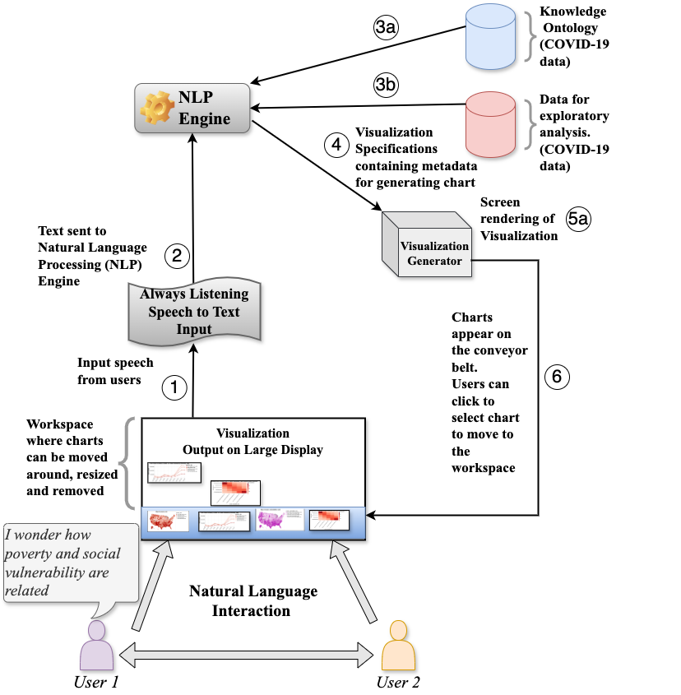
A Conversational Assistant for COVID-19 Data Exploration^{[9]}
Abari Bhattacharya et al. “A Conversational Assistant for Democratization of
Data Visualization: A Comparative Study of Two Approaches of Interaction”. In:
Statistical Analysis and Data Mining (Accepted for Publication) (2024).
Notes:
I developed on the base CA framework built by Abhinav Kumar [12, 13, 14] to create
a CA that supports multi-user collaboration. I also ported the older framework to a
new domain (COVID-19), demonstrating the data-agnostic nature of the architecture.
2. I conducted a user study with the updated CA by recruiting participants from our
University. The study was conducted with the help of Veronica Grosso and Ashwini
Naik, both Research Assistants (at the time) at EVL, in the Fall of 2022. Roderick
Tabalba, a research assistant at the University of Hawaii at Manoa, developed the
CA user interface.
3. I performed post-processing of the collected audio and video data and generated
transcripts of the participants’ conversations during the study. I also analyzed the
post-study semi-structured interview questions.
4. I also carried out a detailed analysis with the user study findings and published them
at peer-reviewed venues [15].

Slide 8
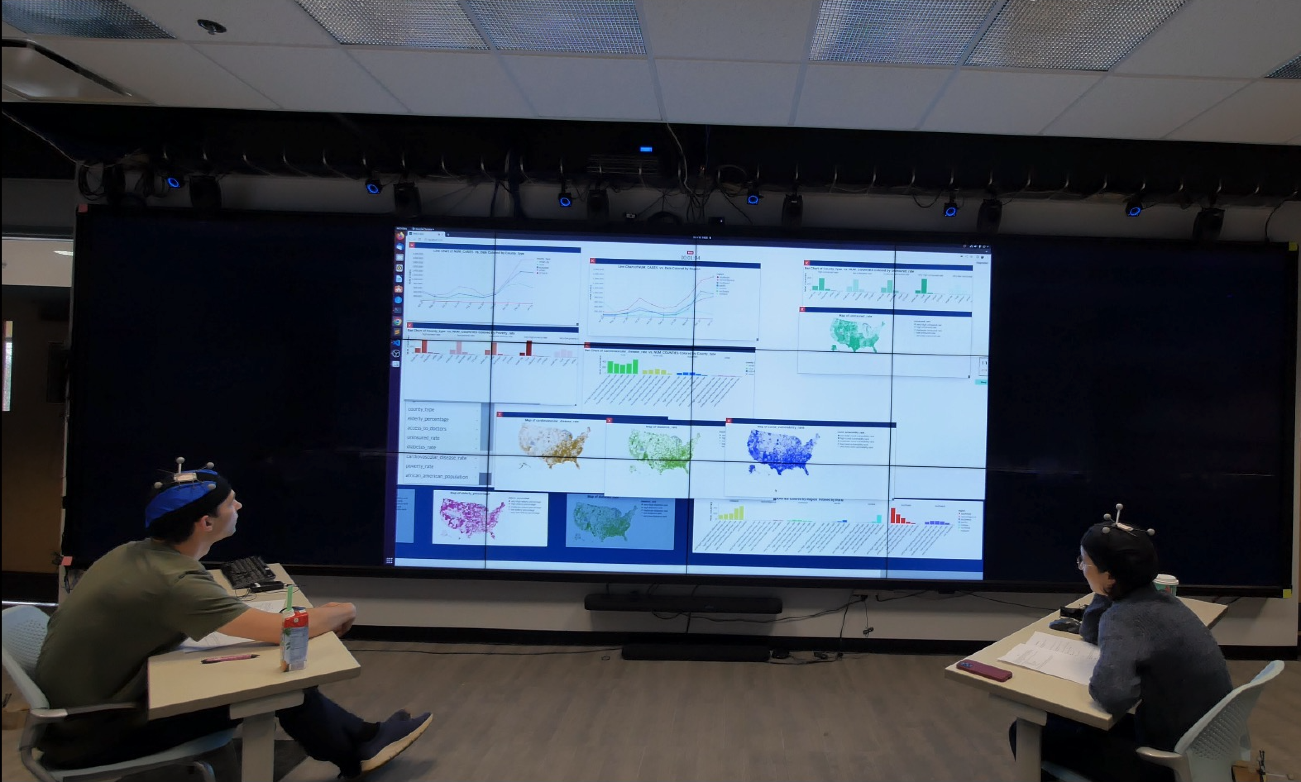
User Study Setup
15 Groups of 2 participants Explored COVID-19 Data For U.S. Counties
Timed Tasks 1 (25 minutes) | What regions and area types in the US should we prioritize for directing resources based on COVID risk, Poverty, Diabetes, Cardiovascular disease, Elderly population, Uninsured, Access to doctors?
Timed Task 2 (25 minutes) | Are there interesting patterns within different sets of counties that might help us understand COVID-19 outbreaks and better prioritize resources?
Open-ended tasks Audio and video recording Users not given instructions on using interface Encouraged to discuss the exploration At the end of each task, participants shared their conclusions as a group Post-study semi-structured interview
Comparative Analysis with a Parallel Study | Supplementing our Analysis Our CA→ Dialogue Manager (DM) Parallel Study → Property Extractor (PE)

Slide 9
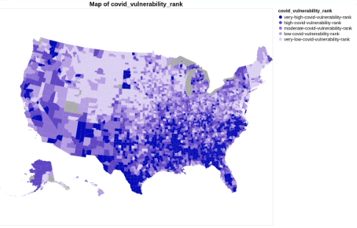
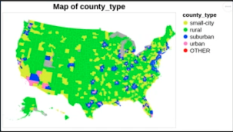
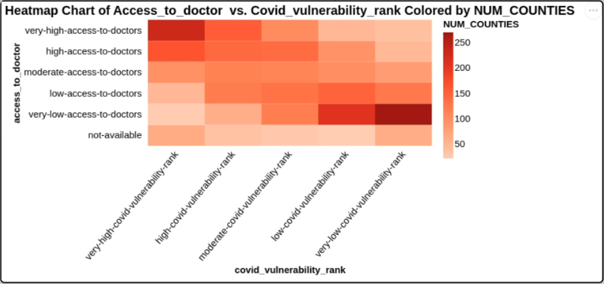
A snippet of the interaction…
 | Conversation | Chart Generated
1 | U1: I think we can do Covid risk first, right? | Choropleth Map by Covid Vulnerability Rank
2 | U2: We have a very high Covid rank. | -
3 | U2: What do you think about it? | -
4 | U1: Should we get a map of the county type first? | Choropleth Map by County Type
5 | U1: Actually, it doesn't say that, well, what is the ongoing problem right now in America? | -
6 | U2: The first is poverty, right? | -
7 | U2: So, I think, wait. | -
8 | U1: Well, I think we can do like Covid risk and then access to doctors and then... | Heat Map by Access to Doctor, Covid Vulnerability Rank
Notes:
Not a direct comment to the system.
Snippet shows no matter to whom the utterance was directed to, system picked up and generated charts. Needs eye gaze etc to analyze but it clearly demonstrate the
Even if the person was by themselves and they had think aloud
Shows that utterances that users use are much richer than simple commands
Compare to woz think alound and in which way the think alouds differ. Also see if human acted on the think aloud.
Compare this to AK’s expt. – setting is different, primed with simple queries
A choropleth map is a thematic map that uses colors or shading to represent aggregate data values across predefined geographic regions

Slide 10
Research Questions (RQ): how CA impacts users in a collaborative EDA scenario. Two CAs: Dialogue Manager (this one) vs simpler Property Extractor
RQ1 (Functionality) How does the functionality of the CA influence user behavior? | RQ 2 (Interpretability) How are the inferences drawn by users from their explorations affected by the CA? | RQ3 (Usability) How are users’ perceptions of the usability of the NLI impacted by the CA?
Different NLP engines produced different interaction patterns More proactive system (PE) → guide exploration toward specific properties Slower system (DM) → more time to reflect and explore more broadly | Users reached different conclusions under the two systems System behavior influenced what users focused on during exploration CA design can shape users’ exploratory paths and inferences | Generated charts were generally seen as useful (72%) Ease of use was mixed(40% Easy/Very Easy, 22% Neutral) On-the-fly learning added cognitive load in collaborative tasks
Study 1 showed that CA design affected user behavior, user inferences, and perceived usability in collaborative EDA.

Slide 11
RQ1: How does functionality of the CA influence user behavior? Two systems: PE (Property Extractor) / DM (Dialogue Manager)
A statistically significant difference between PE and DM in:
#Utterances processed
#Charts generated
#Line charts generated
PE positively associates COVID-19 cases (Tasks 1 & 2)
-proactively generates charts
Line charts of COVID-19 trends by date.
DM shows more significant positive associations with database properties in Task 2.
DM’s slower pace allows for user reflection.
PE’s spontaneous chart generation drives focus on specific properties, potentially narrowing user exploration.
Variables of interest
Utterances processed
Charts generated and selected
Types of charts generated and selected
Database Properties explored
11

Slide 12
RQ2 (Interpretability): How are inferences drawn by users from their explorations affected by CA?
Semantic overlap in conclusions reveals differences in task takeaways and explored “topics” between PE and DM.
PE: Participants mainly focus on exploring COVID-19 case counts across U.S. counties.
DM: Participants delve into other factors like diabetes risk and cardiovascular diseases.
Distinct conclusions drawn by PE and DM users confirm our hypothesis: system architecture influences the nature of conclusions in open-ended exploratory tasks.
Implication: Systems with tendencies toward specific visualizations shape users' exploration paths and conclusions.
Variable of Interest
Semantic similarity between conclusions drawn in PE and DM
Quantifies the similarity of meaning
Low similarity implies potential meaning divergence
12

Slide 13
RQ3: How are users’ perceptions of usability of NLI impacted by CA?
Users generally found NLIs helpful: 72% rate charts as "Useful" or "Very Useful."
40% found the NLIs "Easy" or "Very Easy" to use, with an additional 22% feeling neutral.
Learning to use NLIs without prior instruction added to cognitive demands.
Lack of guidance required participants to adapt quickly while focusing on collaborative tasks with their study partners.
This highlights both the value and usability challenges of NLIs in exploratory data tasks, especially in collaborative settings.
Variables of Interest
Usefulness of the generated visualizations
Ease of command system use
13

Slide 14
Part - 2
Challenges for users
Clarification
Requests

Slide 15
Challenges observed from interactions during the EDA Tasks..
Difficulty in understanding generated visualization
Uncertainty about system capability and procedure
Difficulty in recovering
spoken information
"Can you show me the uninsured rate for different counties?”
Generates a grouped bar chart of uninsured rate, grouping by county-type
“I don’t understand very well, what these bar charts are for?”
“So, it is grouping them by county type.”
“We’ll discuss the comparison of the graph, we can compare it and generate the resources for every disease that we have.
“Sorry, I didn’t get you. So, we already have this COVID?”
“For the COVID, we can come to a conclusion that. . .”
“Can we just mix and match everything and try it?”
“Yeah, I think we need to mix and match two things.”
“Can we do more than two?”
No, I think only two different factors are involved here.”
Notes:
we can see how grounded clarifications appear in the challenging scenarios described in the previous section.

Slide 16
Clarification Requests (CR)
Grounded Clarifications^{[12]} involve CRs tied to specific, real-world contexts or modalities, ensuring mutual understanding between the participants in a conversation
For utterance U, subsequent turn is considered grounded clarification in modality m (e.g., visual, auditory) if there is lack of positive evidence of understanding in that modality
Seeking and providing clarifications is central to human-human communication
Speakers rely on CRs to negotiate meaning, resolve misunderstandings, and coordinate subsequent actions.
[12]Luciana Benotti and Patrick Blackburn. “A recipe for annotating grounded clarifications”. In: Proceedings of the 2021 NAACL

Slide 17
Grounding of Clarification Requests (CR) observed in recorded transcripts of Study 1…
Visual Modality
Auditory Modality
Kinesthetic Modality
Difficulty in understanding generated visualization
Difficulty
in recovering
spoken information
Uncertainty about system capability and procedure
"Can you show me the uninsured rate for different counties?”
Generates a grouped bar chart of uninsured rate, grouping by county-type
“I don’t understand very well, what these bar charts are for?”
“So, it is grouping them by county type.”
“We’ll discuss the comparison of the graph, we can compare it and generate the resources for every disease that we have.
“Sorry, I didn’t get you. So, we already have this COVID?”
“For the COVID, we can come to a conclusion that. . .”
“Can we just mix and match everything and try it?”
“Yeah, I think we need to mix and match two things.”
“Can we do more than two?”
No, I think only two different factors are involved here.”
Notes:
we can see how grounded clarifications appear in the challenging scenarios described in the previous section.

Slide 18
Existing CR Datasets..
Existing datasets (SCARE) ^{[12]} show this grounding can be annotated
But they do not capture real-world collaborative task performance
Other CR datasets are also:
asynchronous
single-turn
not built for collaborative task-oriented dialogue
We need clarification datasets grounded in real-time collaborative task interaction

Slide 19
ClarVis: Annotation, Dataset Description and Context
Annotation
1. CR vs Non CR
2. Grounding Modality
Dataset Description
Quantifying Context
To Do
29 dialogue transcripts ~ 6.9K total turns (including generated visualizations)
~6.3K user utterances
Average 220 turns/dialogue
Context computed: 440 utterances
73.5% of CRs referred to content in the previous two turns
Short dialogue windows are usually sufficient, with slightly more context useful for visual CRs
Visual CRs sometimes reached farther back
Pilot round: 447 utterances
First round: 565 utterances
Disagreements resolved through adjudication before obtaining final labels
κ = 0.89 for CR identification
κ = 0.64 for grounding modality
Disagreements resolved through discussion
To Do
445 clarification requests
6.4% of total turns
7.0% of user utterances

Slide 20
Baseline Experiments using ClarVis dataset
Best CR-ID model
DistilBERT + Prev1
CR F1 = 0.66
CR Precision / Recall = 0.75 / 0.59
Best GMOD model
TF-IDF + Logistic Regression
Visual F1 = 0.73 (+ Prev1)
Kinesthetic F1 = 0.55 (no context)
DistilBERT
Auditory F1 = 0.43 (no context)
Overall baseline pattern on grounding modality classification: Visual > Kinesthetic > Auditory
Takeaways
Baselines show that ClarVis contains learnable signals for both CR identification and grounding modality classification.
Short dialogue context helped CR-ID, especially with DistilBERT.
Visual grounding: most recoverable modality

Slide 21
Labelling Visualization Requests(VIS)
Focus on Visual CRs
Non-CRs in 565 utterances labeled for ‘VIS’
k = 0.91
Auditory CRs:
Gaps in hearing
Kinesthetic CRs:
How to interact with the system
Operate at a more meta-level
Visual CRs:
Tied to system’s core functionality
Concern interpreting generated visualizations
Directed to the co-participant
Final Intent Labels
CR: 445
VIS: 1400
None: 5082

Slide 22
Part - 3
CRs in updated CA

Slide 23
3A. Developing Clarification-Aware Conversational Assistant and User Study Design (Study 2)

Slide 24
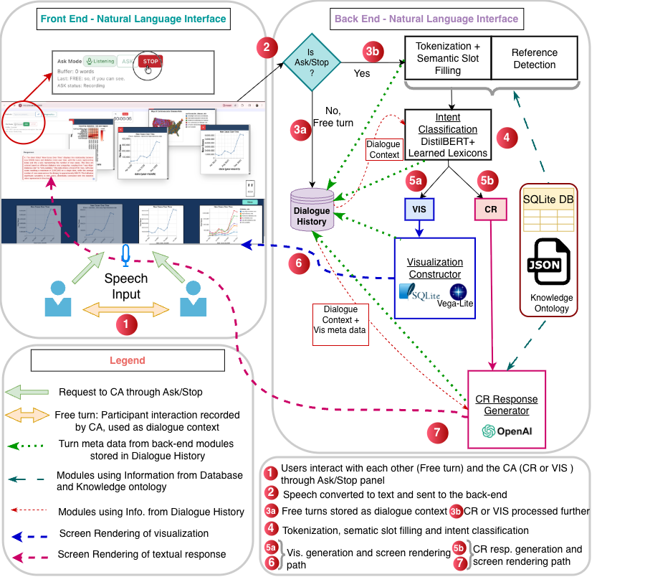
A Clarification-Aware Conversational Assistant (CA) Pipeline for
Collaborative Data Exploration
Why the pipeline architecture?
Multiple subtasks of interest:
intent detection
reference resolution
visualization construction and generation
clarification response generation.
More controllable and interpretable:
Each stage can be debugged, evaluated, and improved separately while keeping outputs grounded in the data.

Slide 25
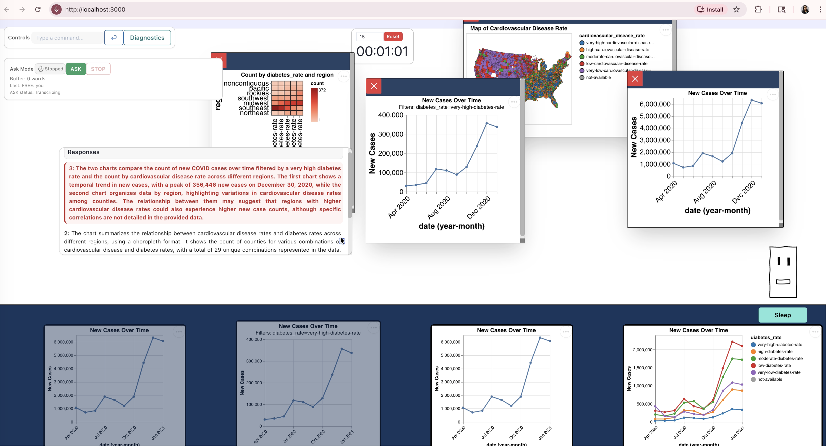
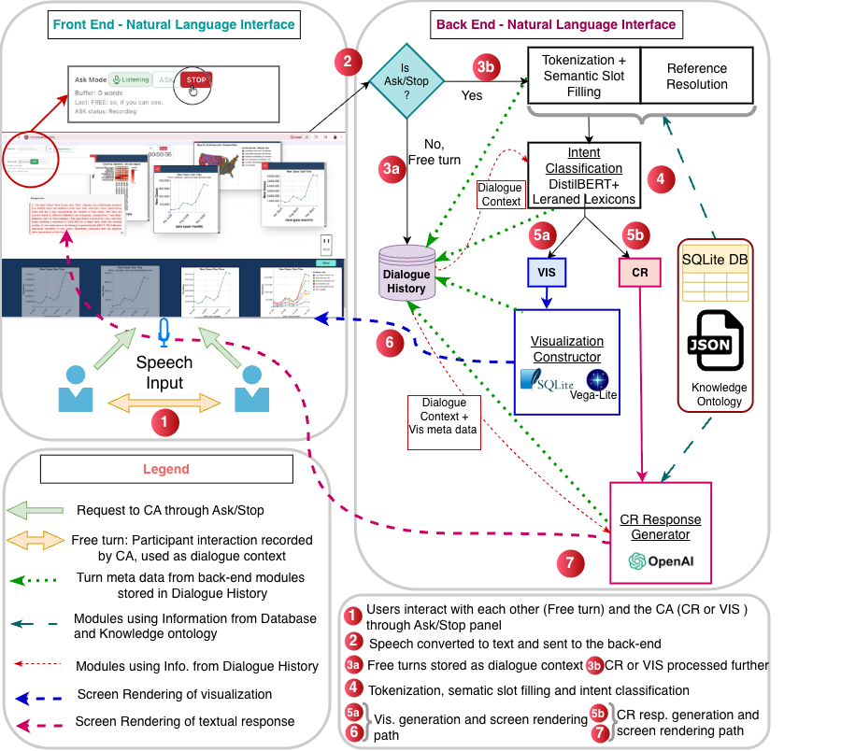
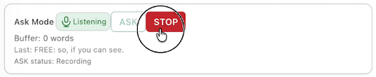
A Clarification-Aware Conversational Assistant (CA) Pipeline for
Collaborative Data Exploration : Natural Language Interface
Two speech input modes:
Ask/Stop: Directed to the CA
Free: Directed to the co-user

Slide 26
Back- End Components - 1
Tokenization and Semantic Slot Filling: “Cardiac ailments <cardiovascular disease rate> in the west coast <region: pacific>”
Reference Detection: “Can you explain what exactly each color represents in this chart?”
Intent Classification (CR, VIS, None)
DistilBERT (focal loss)+ Prev3 (trained on ClarVis)
CR(75.0/73.1/74.0)
VIS (79.2/81.0/80.1)
None( 92.5/92.1/92.3)
Learned Lexicons for Visual Modality CR (CR-V)
Symbolic post-processing override for low confidence (Prob. <0.55) Intent model prediction
394 CR-V phrases learned from training data: ≥3 occurrences and ≥55% CR-V association.

Slide 27
Back- End Components - 2
VIS branch
Resolved semantic slots → Chart type selection
→ SQL query construction → Vega-Lite spec generation
CR branch
Prompting strategy:
Structured evidence-grounded prompting
gpt-4o-mini
System prompt (fixed) + User prompt (dynamic runtime context)
Prompt:
System: CR type (explanation / chart element meaning / comparison) → generate grounded answer from ordered chart/data evidence
User: utterance + reference chart + recent turns + resolved slots + supporting facts/statistics

Slide 28
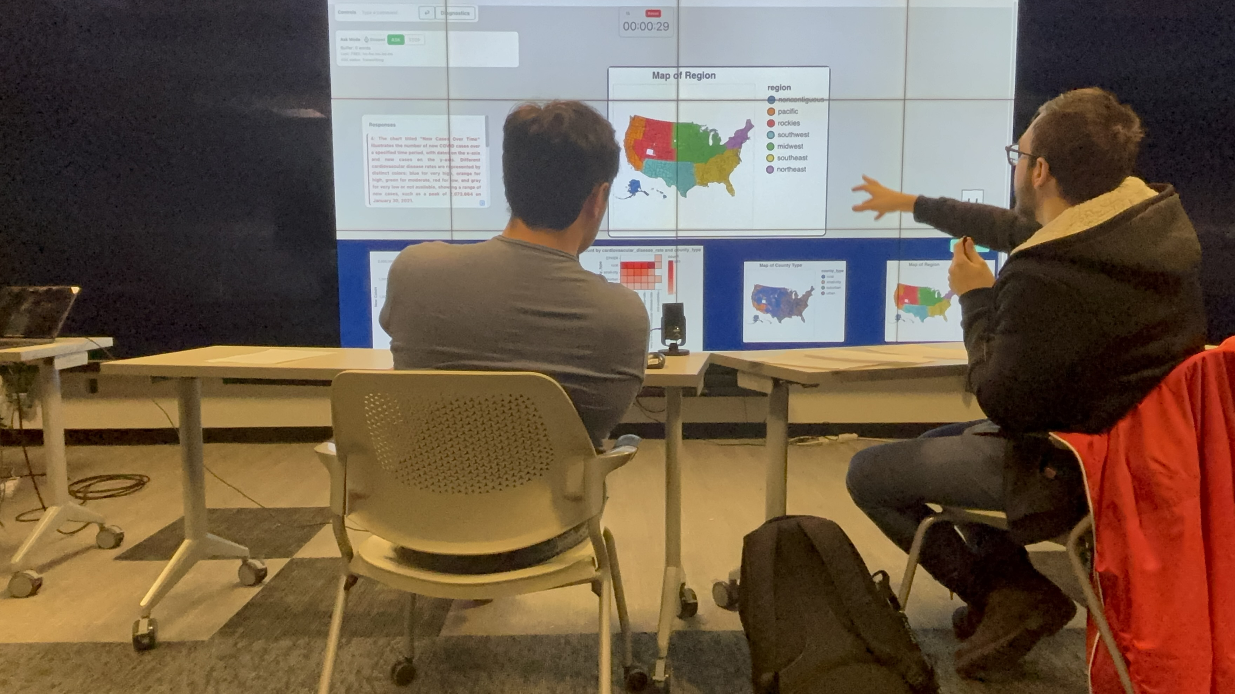
A Clarification-Aware Conversational Assistant (CA) Pipeline for
Collaborative Data Exploration : User Study Design
Exploratory single-condition study:
Understand how users used the clarification-aware CA in practice
Participant instructions
Introduced system as research prototype
Work collaboratively
Use charts + textual responses to visualization-related questions as evidence
Rely only on provided COVID-19 dataset
Speak clearly, stay task-focused
38 participants → 19 Groups
No overlap with earlier user studies
Age 18–29 (M = 22.82, SD = 3.01)
Mostly computing-related majors
Prior visualization experience: 19 regular / 14 some / 5 none
Design choices
Encouraged CRs: framed as “questions about data visualizations”
Task structure: 5-min warm-up + 3 x15-min tasks
Open ended EDA tasks
Seed questions / examples: To support visualization requests and visualization-related questions
All sessions were Audio, Video and Screen Recorded.
Session Logs from the code were also collected for analysis.

Slide 29
3B. Analysis of Data Collected from User Study (Study 2) Logs

Slide 30
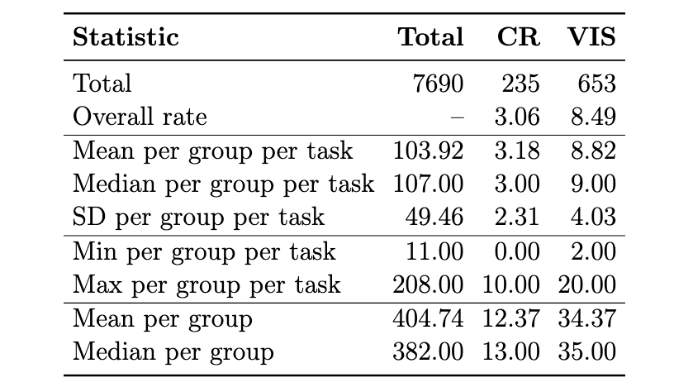
Analysis of Data Collected From the User Study : Interaction Profile through CR & VIS
Participants primarily engaged with the system as a tool for generating visual evidence.
CRs played a more secondary, supporting role
Aligns well with study design → core task was collaborative EDA rather than question answering alone.
Consistent with prior work → although CRs play an important role in grounding and repair → usually make up only a small share of utterances in dialogue corpora

Slide 31
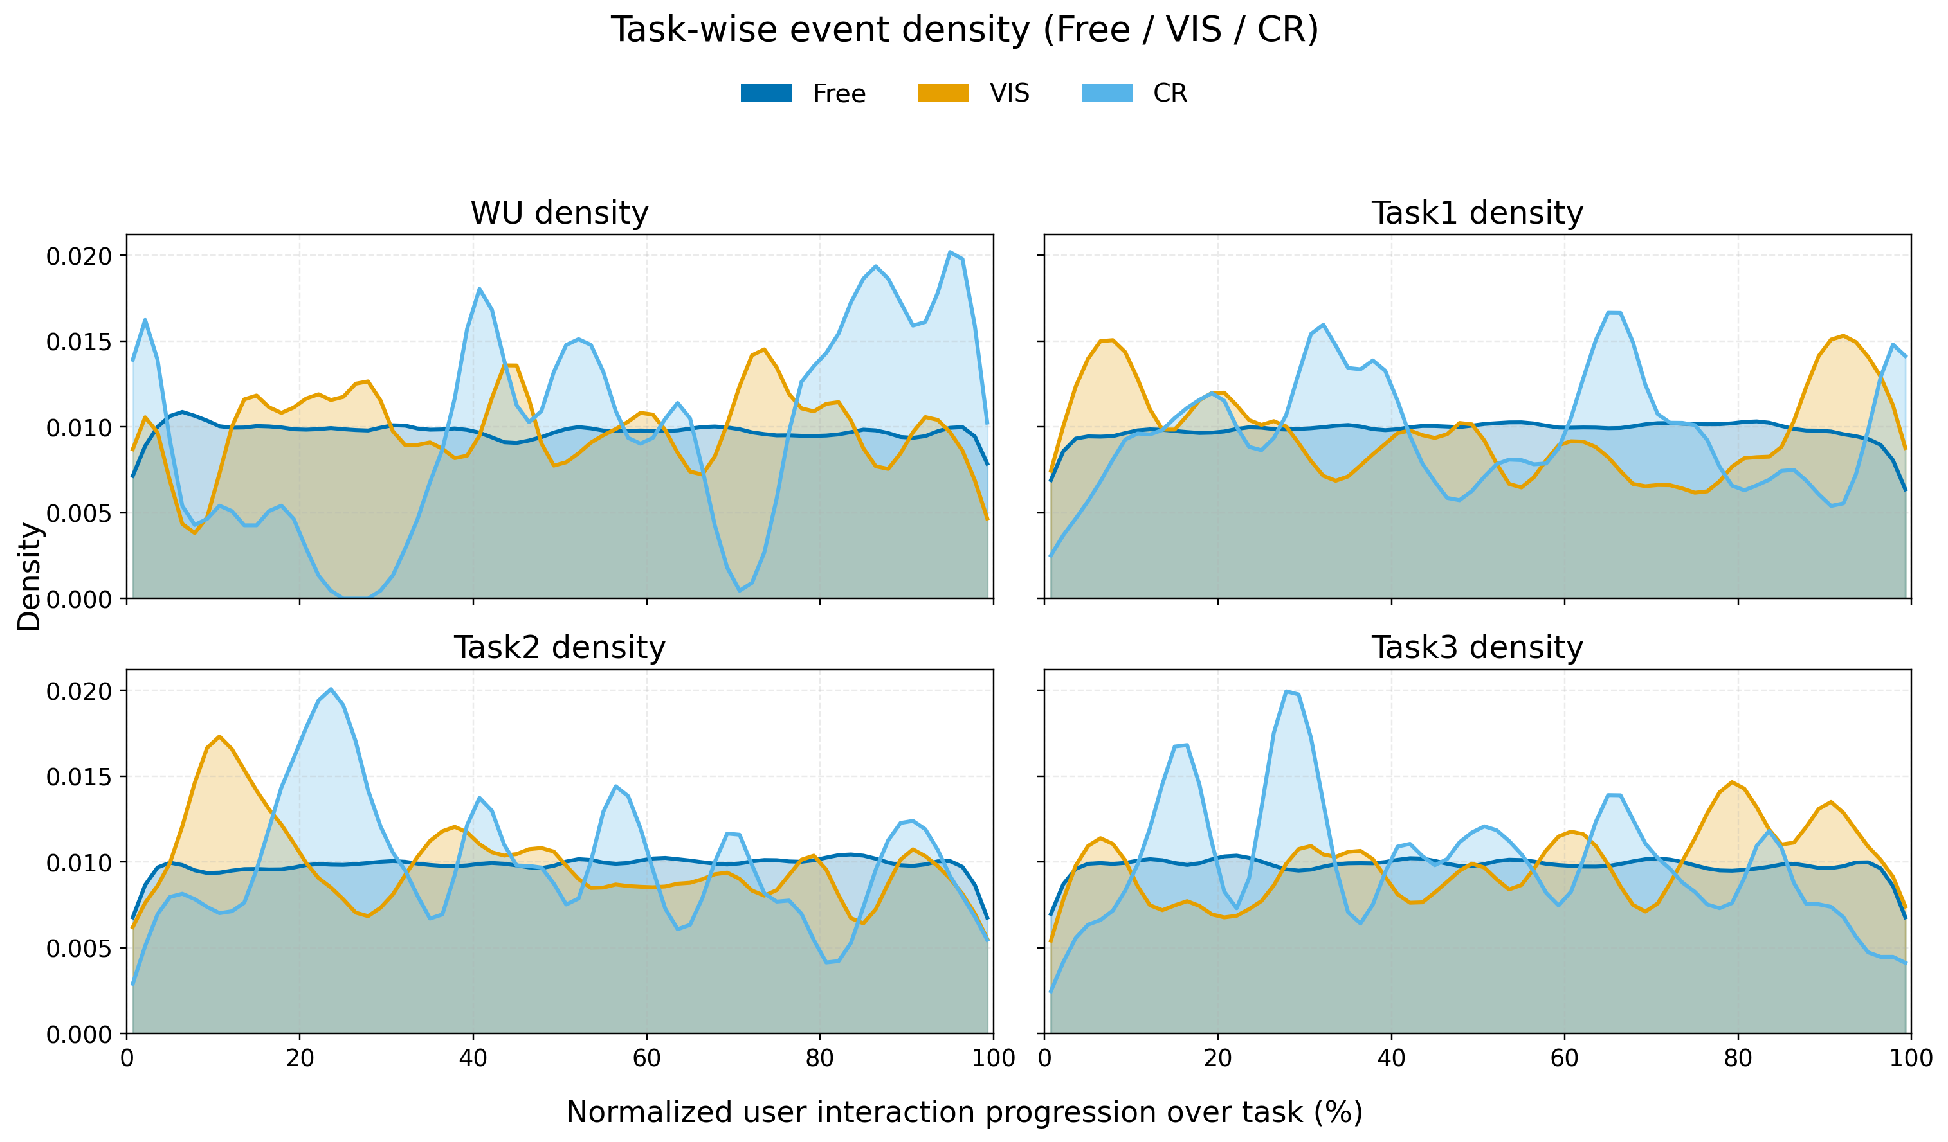
Analysis of Data Collected From the User Study : Interaction Profile through CR & VIS
Density patterns
Free turns: spread more evenly across tasks ; VIS and CR: showed more localized peaks
Warm-up: VIS spread across task; CR near the end
Task 1: VIS → CR → VIS pattern
Task 2: CR rose soon after an early VIS peak
Task 3: CR appeared earlier, VIS later
What followed CR responses
CR → VIS: 146 / 235 (62.13%)
CR → CR: 66 / 235 (28.09%)
CR → Free: 23 / 235 (9.79%)
CRs was episodic and not the same across all tasks.
Emerged at moments of uncertainty or interpretation
Clarification responses possibly helped users return to visualization generation rather than remain in repair

Slide 32
Analysis of Data Collected From the User Study : System’s Responses to CRs
Checklist-based LLM-as-a-judge Inspired by CheckEval - More interpretable and stable than one overall rating
4 dimensions: Correctness, Groundedness, Helpfulness, Clarity
Scoring:
5 yes/no checks per dimension
20 binary checks per response
Score = % yes per dimension
Judges – prompted with the CR, Response and Dialogue Context along with the scoring rules
gpt-4.1-mini (note: used gpt-4o-mini to generate CR responses)
gemini-2.5-flash-lite
qwen2.5-14B-Instruct
Notes:
Correctness captures whether the response is factually and contextually accurate given the clarification request, the recent dialogue, and
the visualization-related evidence. Groundedness captures whether the response is meaningfully anchored in the provided chart, dialogue, and supporting evidence, rather than being generic, speculative, or unsupported. Helpfulness captures whether the response helps resolve
the confusion raised in the clarification request so the users can better understand the issue in the current exploratory data analysis task. Clarity captures whether the response is understandable, coherent, concise, and easy to follow.

Slide 33
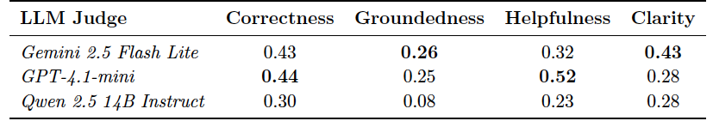
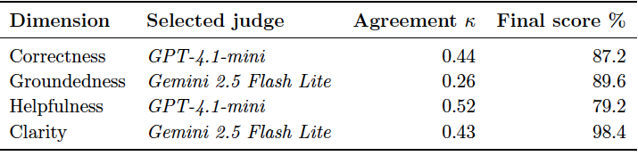

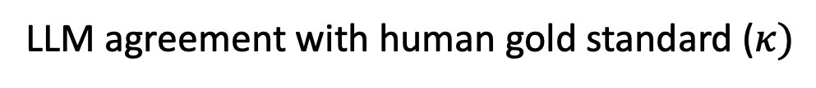
Humans & LLMs as judges
2 coders, 50 CRs: Cohen’s $κ$
LLM agreement with human gold standard ($κ)$
Correctness | 0.647
Groundedness | 0.540
Helpfulness | 0.637
Clarity | 0.350
Final Assessment of responses

Slide 34
3D. Analysis of Data Collected from User Study (Study 2): Post Study Questionnaire

Slide 35
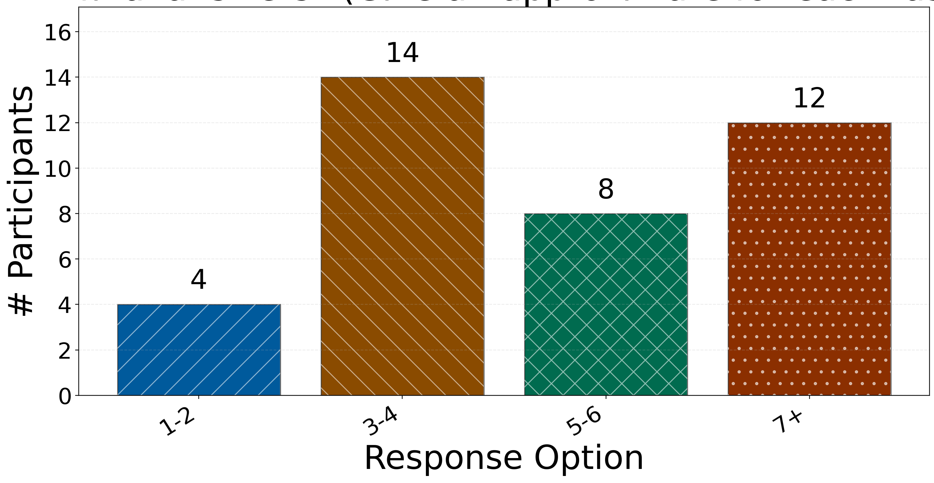
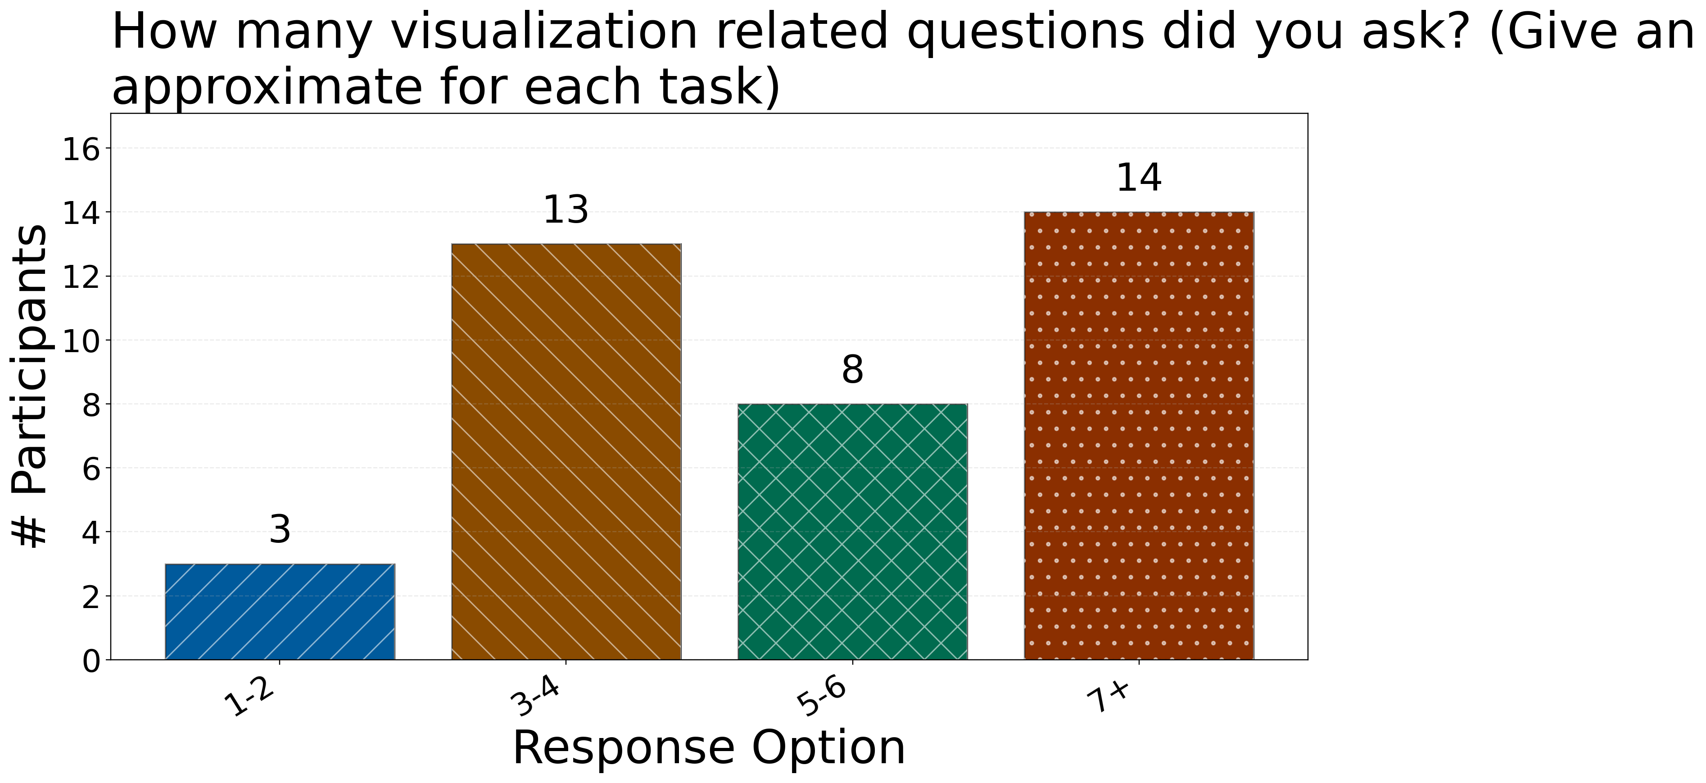
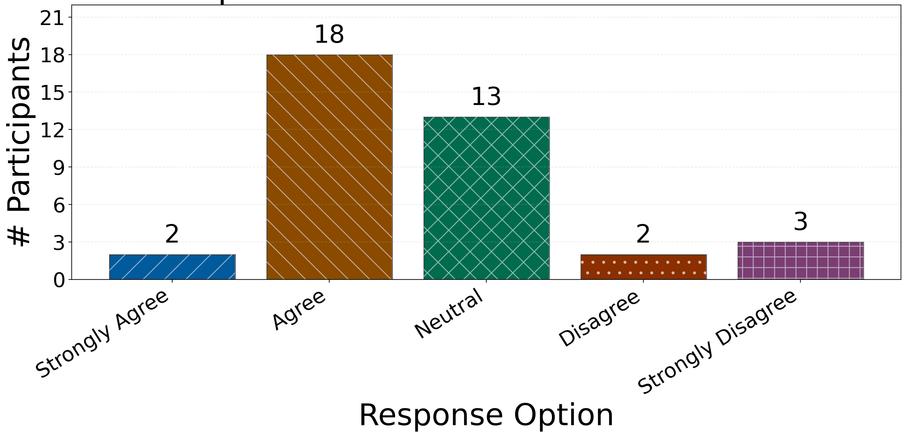
Post Study Questionnaire : Chart Use, Visualization-Related Questions, and Perceived Usefulness
How many charts did you actively use as evidence
for your final answers? (Give an approximate for each task)
How many visualization-related questions did you ask? (Give an approximate for each task)
The system’s textual responses to your questions were useful for task completion.
Significantly associated

Slide 36
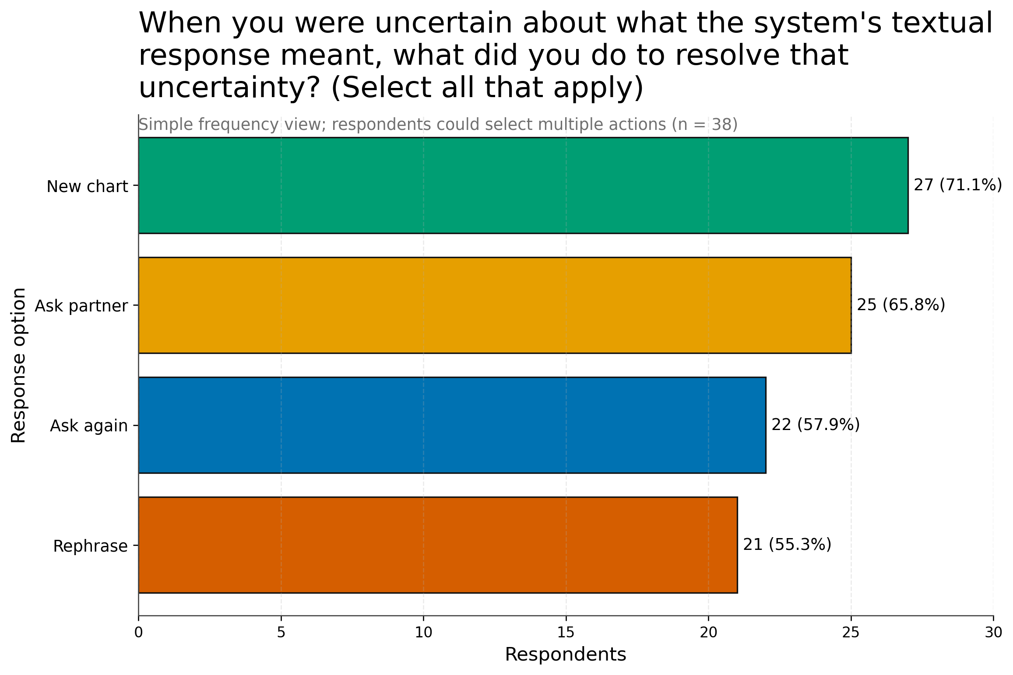
Post Study Questionnaire : Participant-Reported Response Handling

Slide 37
Conclusion: Why This Research Direction Matters?
AI-assisted visual analysis is growing Recent systems support AI assistance, GenAI-based visual analytic conversations, iterative visualization creation, and more complex text-to-visualization outputs.
But user experience is still underexplored We need more evidence on how users work with CA support during analysis: how they interpret outputs, handle uncertainty, and continue the task.
This matters beyond one system As data-driven decision-making becomes more common, people need tools that help them make sense of data collaboratively.
This dissertation points to one path forward A clarification-aware CA can support collaborative data exploration by combining: accessibility + visualization + clarification support
Broader takeaway The full goal is not yet achieved, but this work shows that natural, clarification-aware, collaborative CAs are a meaningful direction for making data exploration more accessible, interactive, and useful.

Slide 38
Conclusion: Future Extensions
Other datasets and EDA tasks Test the clarification-aware CA with different datasets and exploratory analysis tasks.
Larger collaborative groups Study how the CA supports groups with more than two users, where coordination and shared understanding may be more complex.
Less constrained data-exploration settings Evaluate the CA in longer and more varied collaborative settings, such as classroom, workplace-style planning, or public-health/policy analysis tasks.
Other AI-assisted data tools Apply the clarification-focused analysis to dashboard, spreadsheet, or report-generation assistants, where users may also need to question, verify, or repair AI-generated outputs.

Slide 39
Appendix

Slide 40
Natural Human-Human Conversations are Characterized by …
1 | User 1: I think we can do Covid risk first, right?
2 | User 2: We have a very high Covid rank.
3 | User 2: What do you think about it?
4 | User 1: Should we get a map of the county type first?
5 | User 1: Actually, it doesn't say that, well, what is the ongoing problem right now in America?
6 | User 2: The first is poverty, right?
7 | User 2: So, I think, wait.
8 | User 1: Well, I think we can do like Covid risk and then access to doctors and then...
References to prior queries to accommodate the contextual information
Ambiguous utterances
Incomplete queries

Slide 41
To explore how addressing the identified challenges faced by users in Study 1 shape user interaction with an updated CA, I ask the following Research Questions..
RQ4: How do the system’s responses to user-initiated clarification requests relate to the interaction flow and task progress during collaborative data exploration?
RQ5: How do users perceive the usefulness and interpretability of these responses for the EDA task completion?
Update existing CA framework so that it identifies user-initiated CRs and responds to those CRs
Design a user study with the updated CA to answer RQ4 and RQ5

Slide 42
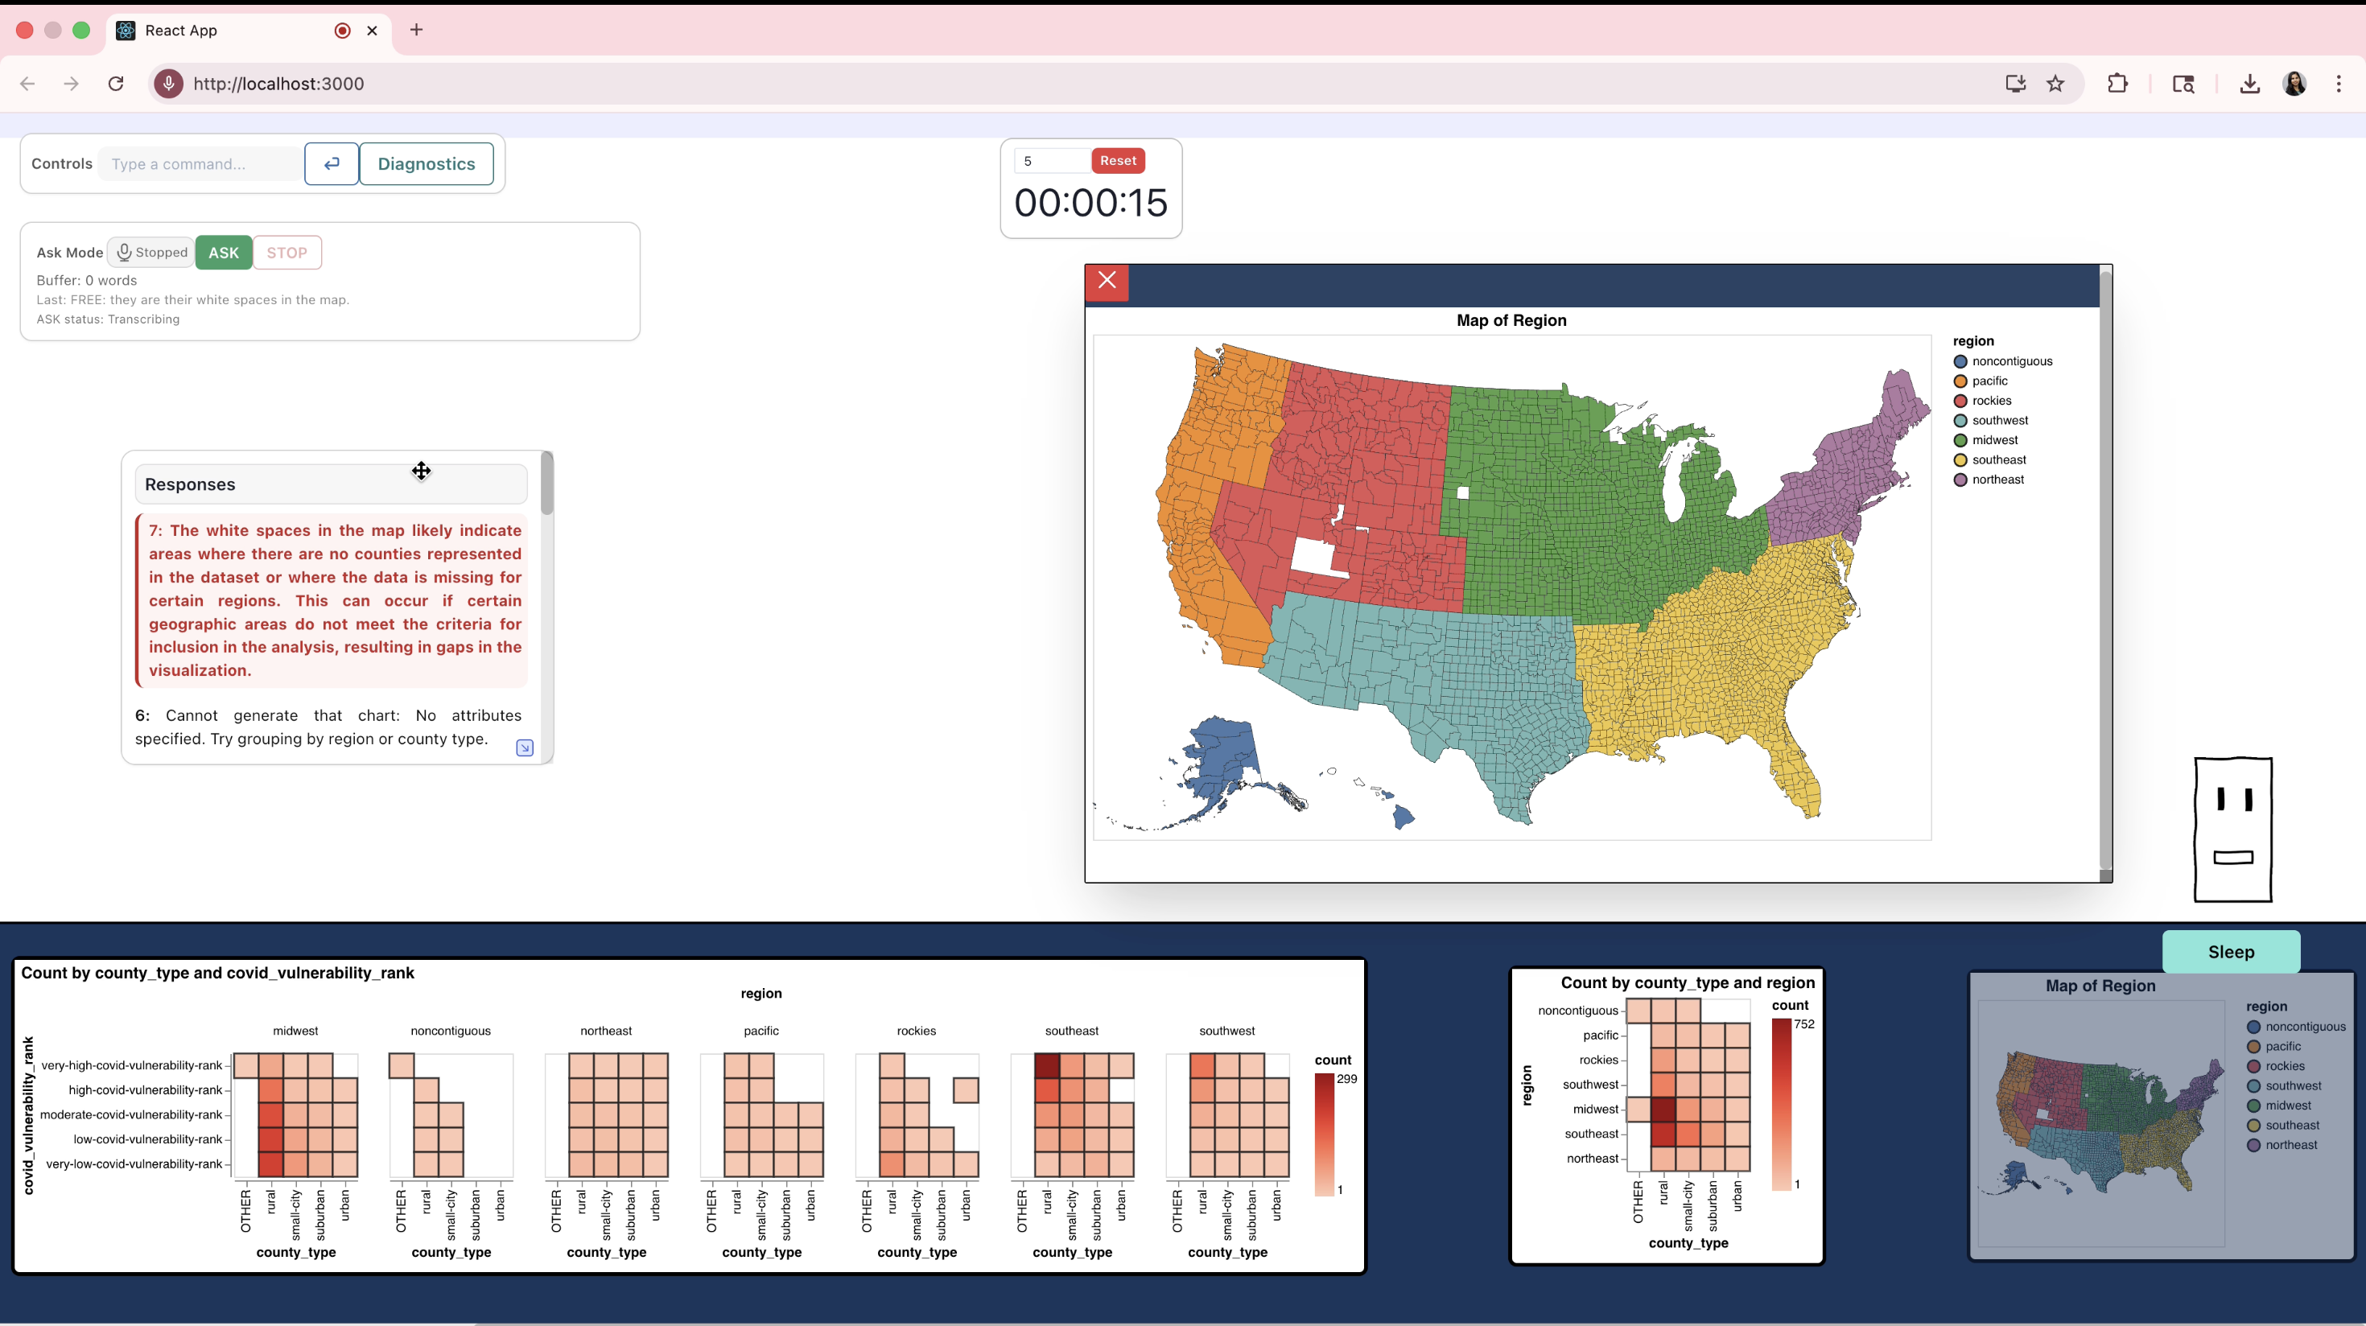
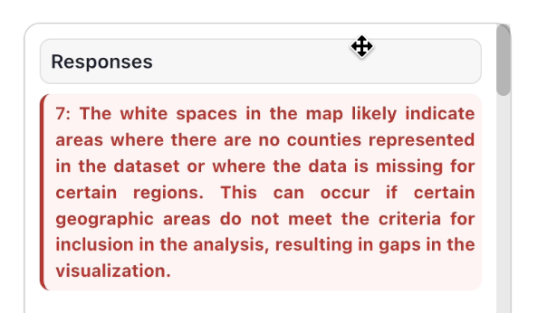
A Clarification-Aware Conversational Assistant (CA) Pipeline for
Collaborative Data Exploration – Sample Conversation
Group 21 Warm Up Task
17 | Give me a bar chart for that | User1 | VIS
18 | by the region | User1 | VIS
19 | they are their white spaces in the map. | User2 | Free
20 | Why are there white spaces in the map? | User1 | CR

Slide 43
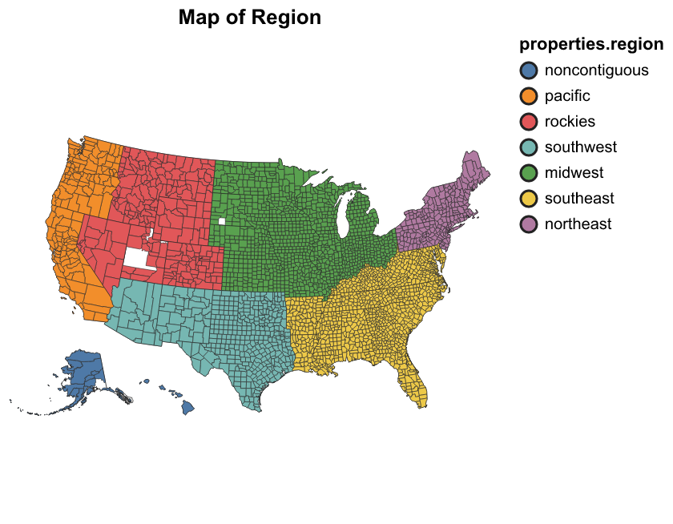
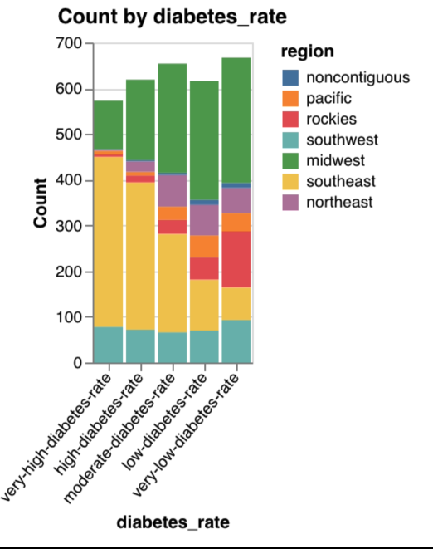
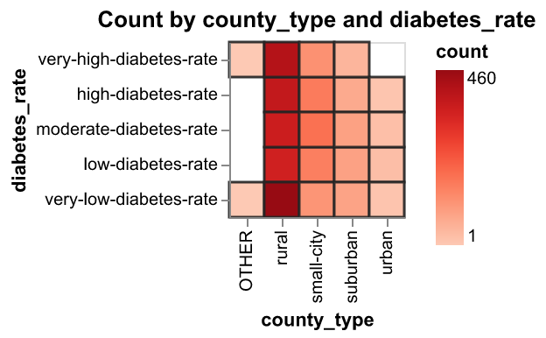
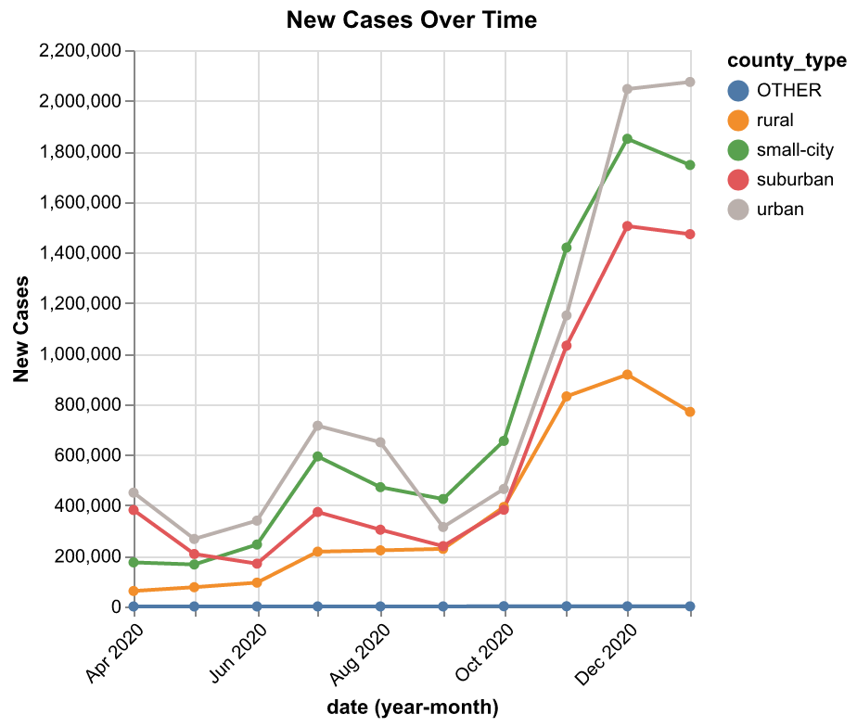
A Clarification-Aware Conversational Assistant (CA) Pipeline for
Collaborative Data Exploration : Charts Types

Slide 44
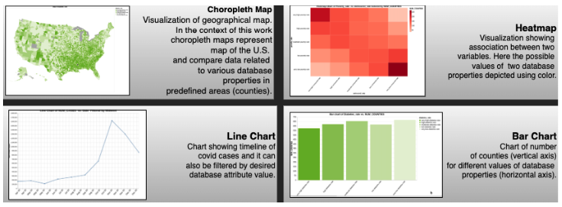
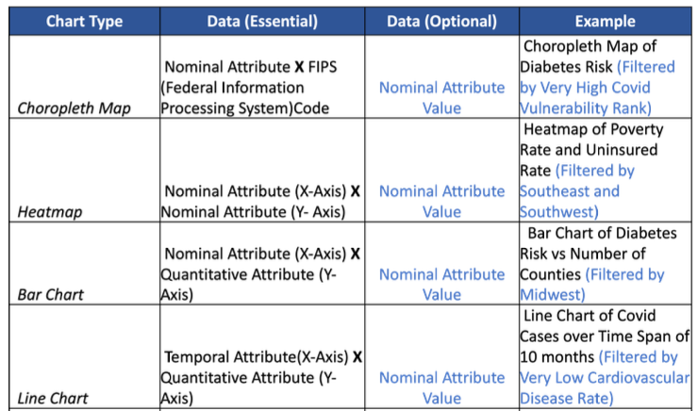

Slide 45
Data Collected From the User Study: Open Ended Task Conclusion Analysis - Group-Task Aggregation
Why aggregate at the group-task level?
Tasks were completed collaboratively
Each group-task as the unit of analysis.
The coded final task conclusions were treated as indicators of progress toward a task-closing interpretation, not as correctness scores, because the EDA tasks were open-ended.
Aggregation rule: For each group-task → higher score across the two participants.
Why this rule? This captures whether a clear conclusion, justification, or use of evidence appeared anywhere in the group’s final interpretation.
Dimension | Participant-level coding
Conclusion presence | 1 = no/weak, 2 = partial, 3 = clear
Justification | 1 = none, 2 = some, 3 = elaborated
Evidence use | 1 = none, 2 = any evidence used
Main task-progress takeaway
After Warm-up, groups more often ended with recognizable conclusions, frequently accompanied by at least some justification and evidence use.
This suggests that participants were generally able to work toward plausible task-closing interpretations once they moved beyond the initial orientation phase.

Slide 46
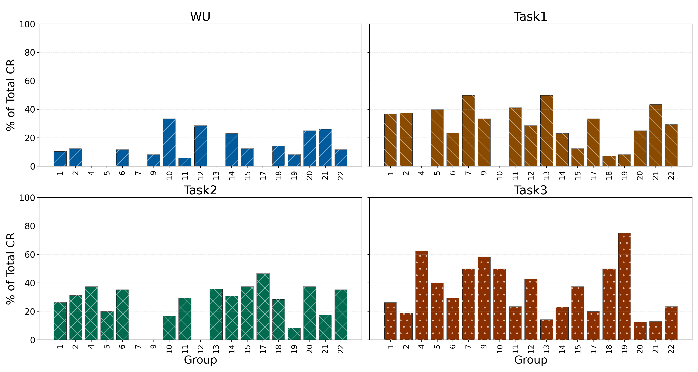
Analysis of Data Collected From the User Study : Interaction Profile through CR & VIS
Warm-up: smallest avg. CR share 12.21% → exploration-heavy onboarding phase
Task 1: 30.78%
Task 2: 24.96%
Task 3: largest avg. CR share 35.30%
Within-group percentage distribution of CR-s across tasks
Task-level concentration shows where CRs became more prominent → the next step is to see how they unfolded within the interaction itself.

Slide 47
3C. Analysis of Data Collected from User Study (Study 2) :Open-ended EDA Task Conclusions

Slide 48
Open Ended Task Conclusion Analysis
Each Participant’s articulated task-closing interpretations were characterized along 5 dimensions:
conclusion presence
coherence
justification
evidence use
uncertainty
Reaching a conclusion and expressing it clearly were not the same “Southeast..” (G7_T1_1), “Rural, southeast” (G9_WU_1)
Justification and referring to evidence “the heatmap shows the covid vulnerability is high..” (G4_WU_1)
Elaborated reasoning “there are lot of people with more uninsurance … it seems like it is moving in opposite directions” (G1_T3_2)
Brief, tentative, or partially justified conclusion
“It is similar in southeast” (G5_T1_2)
Clear conclusion “To answer the question, I think the insured rate and access to doctor move in the opposite direction” (G2_T3_2)
Uncertainty
“we were confused ... so I am not sure” (G1_T1_1)
Task-wise Pattern (%participants in task conclusion categories)
 | Warm-Up | Tasks 1-3
Clear conclusions | 36.8% | 64.7–68.4%
Any justification | 36.8% | 57.9–70.6%
Any Evidence | 47.4% | 55.3–79.4%

Slide 49
Open Ended Task Conclusion Analysis
After the warm-up, participants generally reached stronger, more justified, and more evidence-based task-closing interpretations.
Task 1: highest justification and evidence use
Task 2: least uncertainty
Task 3: most clear conclusions and elaborated justification
However, this broader progress was not explained by
CR/VIS frequency
averaged LLM-judge response-quality scores.
Overall, the findings suggest
Clarification responses mattered within collaborative EDA → mainly as part of local processes of verification, repair, and sense-making, rather than predictor of broader task outcomes

Slide 50
Post Study Questionnaire: Participant-Reported Response Handling: Group-Level Response Difficulty Variable
Group 1:
How was the variable derived?
Unclear:
U1 = 3–4
U2 = 3–4
Unexpected:
U1 = 3–4,
U2 = 3–4
Restating:
U1 = N
U2 = 1–2
Response difficulty count = 1+1+0 = 2
For each difficulty type, a group receives 1 if either participant selected a higher-frequency category (3–4 or 5+), and 0 otherwise
$$response difficulty= unlcear_any_high+unexpected_any_high+restating_any_high$$
𝑟𝑒𝑠𝑝𝑜𝑛𝑠𝑒 𝑑𝑖𝑓𝑓𝑖𝑐𝑢𝑙𝑡𝑦= 𝑢𝑛𝑙𝑐𝑒𝑎𝑟_𝑎𝑛y_ℎ𝑖𝑔ℎ+𝑢𝑛𝑒𝑥𝑝𝑒𝑐𝑡𝑒𝑑_𝑎𝑛𝑦_ℎ𝑖𝑔ℎ+𝑟𝑒𝑠𝑡𝑎𝑡𝑖𝑛𝑔_𝑎𝑛𝑦_ℎ𝑖𝑔ℎ
Score ranges from 0 to 3.
This variable was used only as an exploratory summary measure.
Restating was the most common higher-frequency (12/19 groups)
Unclear was less common (5/19 groups)
Unexpected was least common (3/19 groups)
Most groups were low-to-moderate on response difficulty (14/19 groups scored 0–1)

Slide 51
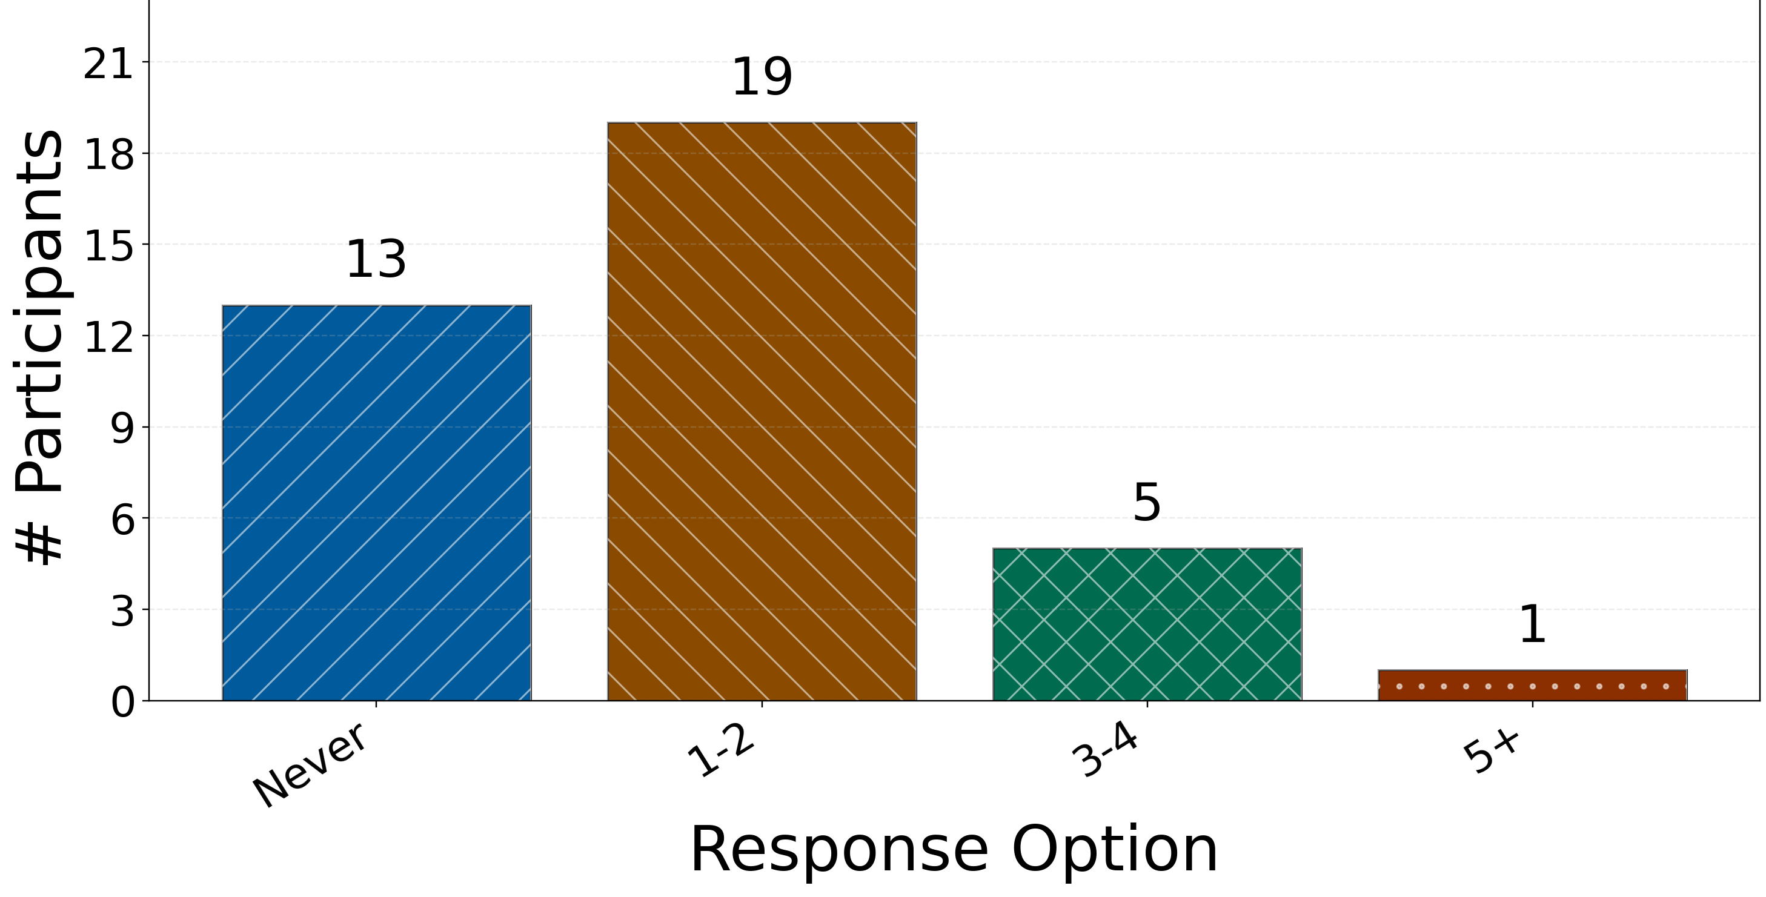
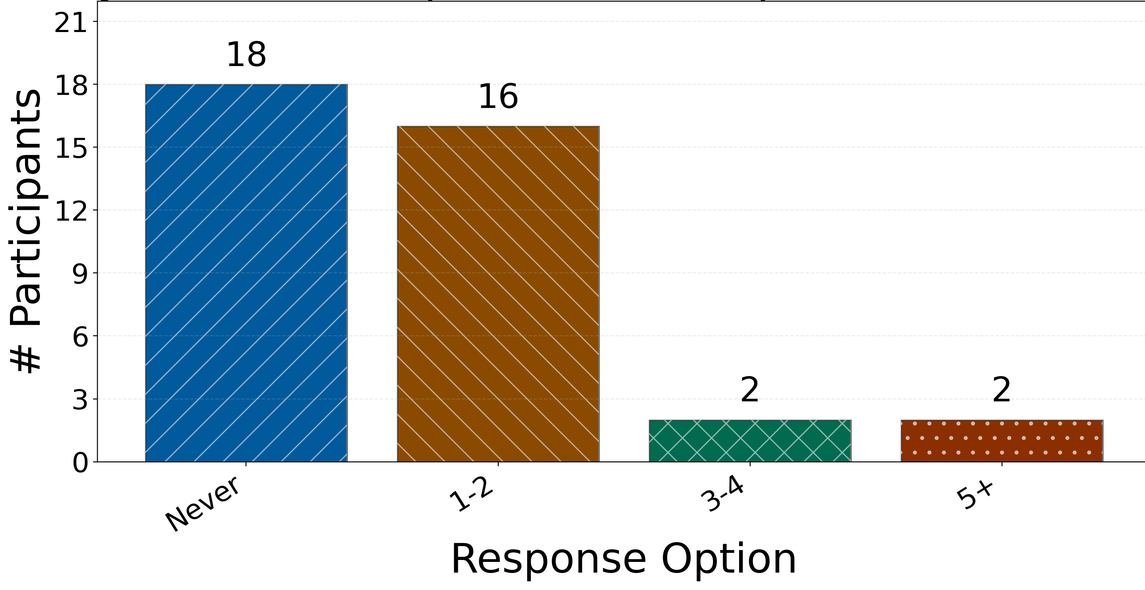
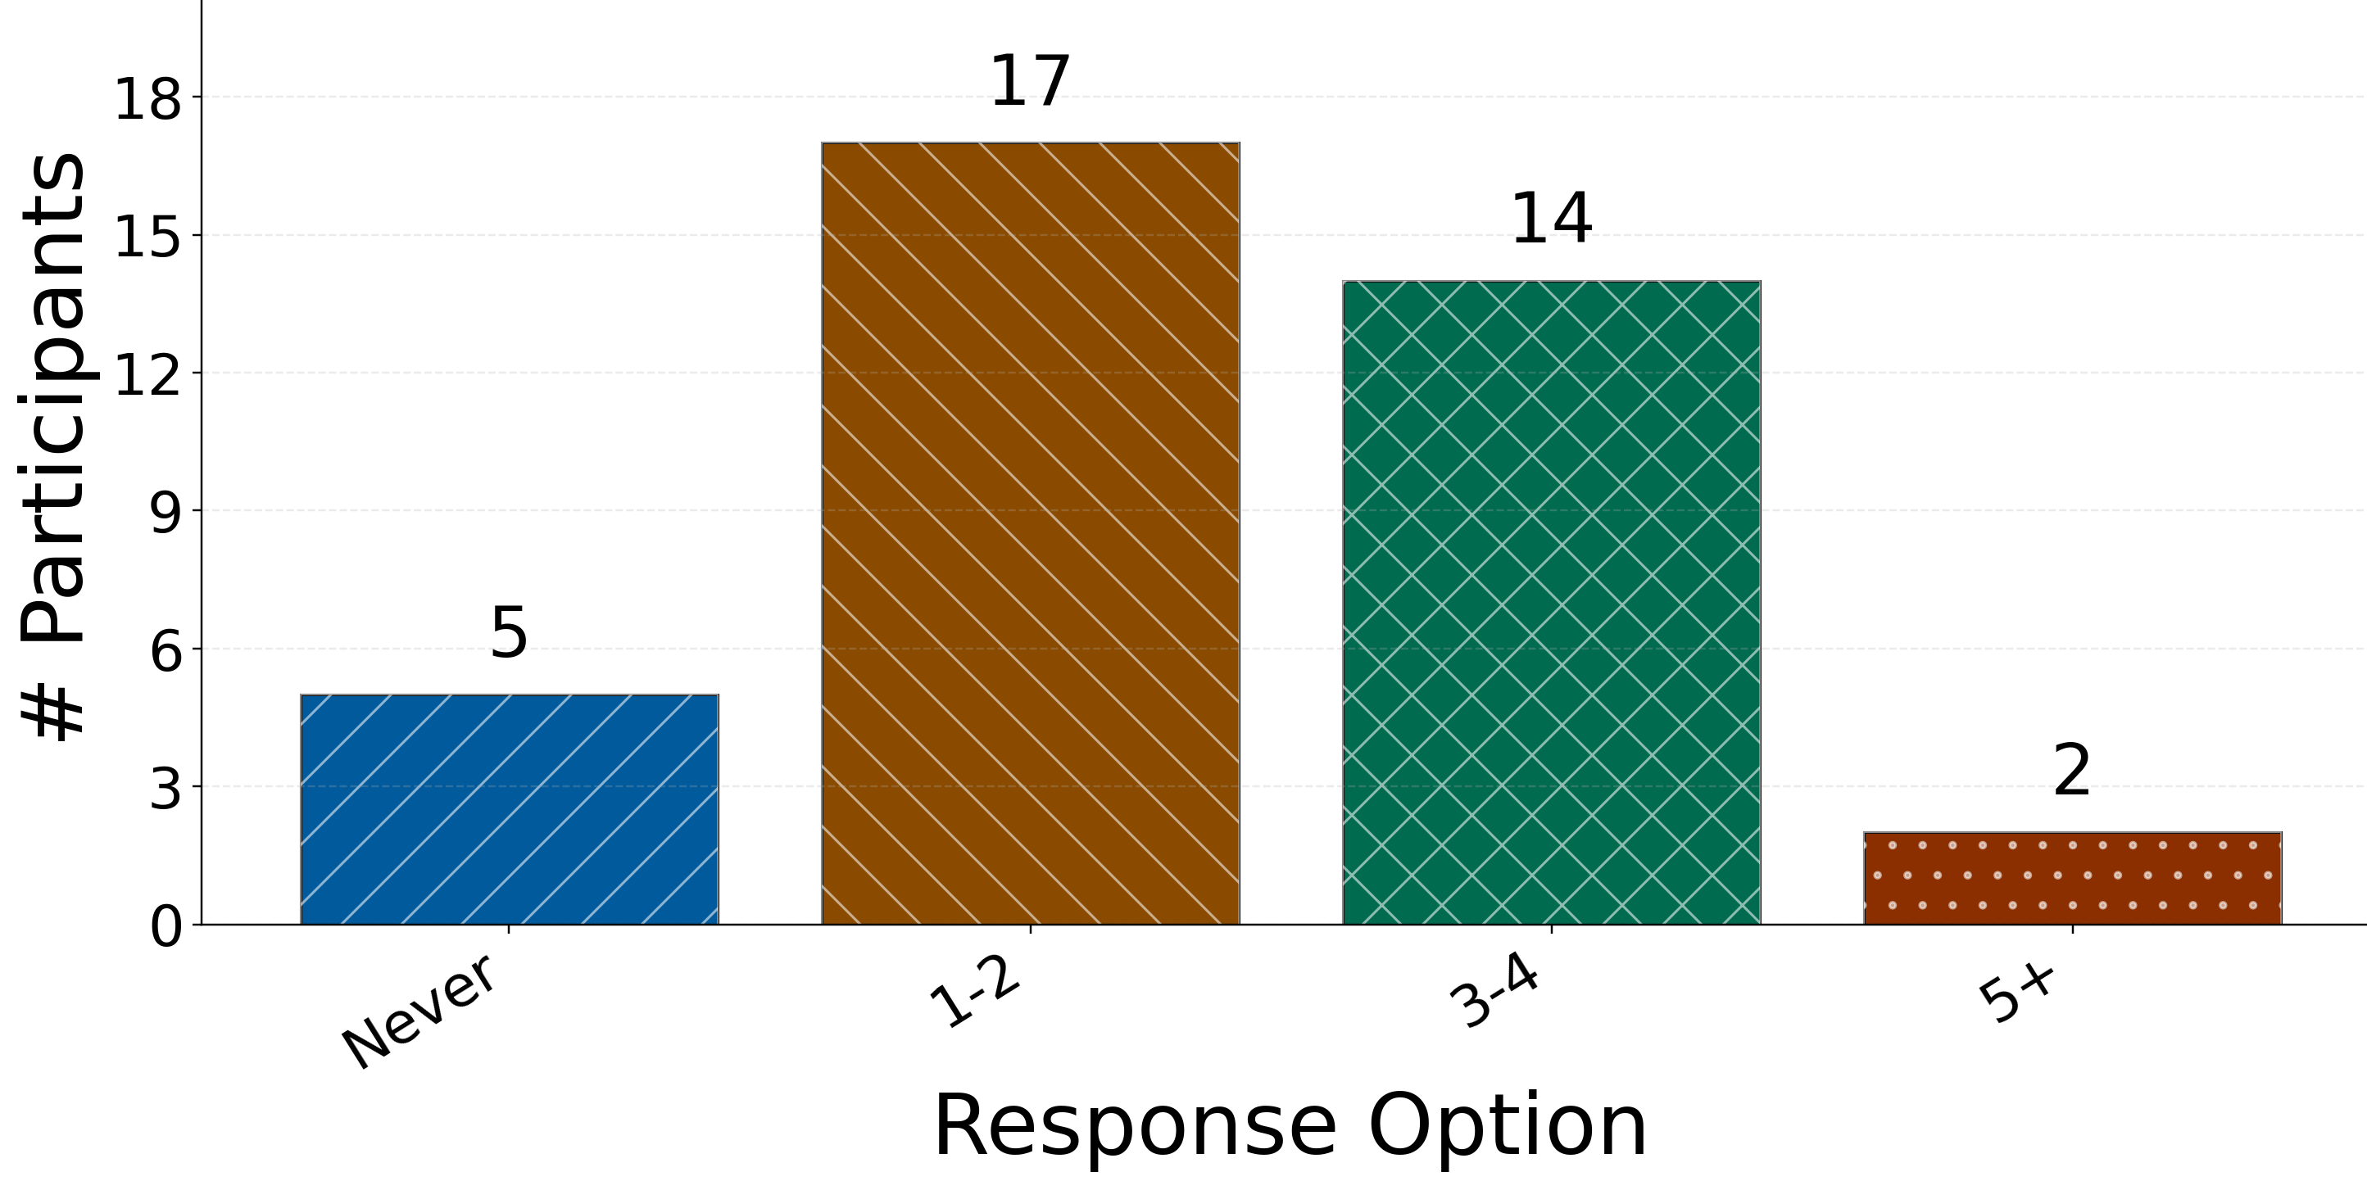
Post Study Questionnaire: Participant-Reported Response Handling
Were there times when the system produced a text response to your question but you did not know what it was referring to?
Were there times when the system produced a text response
when you had not expected that response?
referential clarity→ whether the response made sense after it was produced
Were there times when you needed to restate the question multiple times before moving forward?
expectation match / mismatch → what users thought the system should do and what it actually produced
repair / reformulation indicator → participants had trouble with the response

Slide 52
Post Study Questionnaire: Open Ended Questions
Reflexive thematic analysis: strategy and chart preferences
What was your overall strategy for completing the tasks?
What kind of charts did you request the most and why?
Theme 1: Iterative visual sense-making
Pattern | Participants | Example quotes
Task decomposition and stepwise exploration | 13 / 38 | “Starting with a basic chart and then asking questions further” (G2-U1)
Strategy refinement based on visual feedback | 25 / 38 | “..try plotting common attributes and then find a common relation in the end between the plots you have generated” (G13-U2)
Takeaway:
Understanding was built gradually through successive visualizations, interpretation, and revision rather than through a single system response

Slide 53
Post Study Questionnaire : Open Ended Questions
Reflexive thematic analysis: strategy and chart preferences
What was your overall strategy for completing the tasks?
What kind of charts did you request the most and why?
Theme 2: Chart interpretability
Pattern | Participants | Example quotes
Preference for relationship-revealing charts | 15 / 38 | “Heat maps made sense to use for most of the questions to see if they correlate” (G1-U2)
Preference for visually straightforward charts | 16 / 38 | “bar chart and as it is easy to find the maxima/minima at a glance” (G11-U2)
Takeaway:
Participants favored charts that supported quick pattern recognition and were easy to interpret.

Slide 54
Post Study Questionnaire : Open Ended Questions
Reflexive thematic analysis: response uptake and system interpretation
Think about a visualization-related question you asked and the system’s response. What did you do after the system responded?
What did you think the system was using to answer your question about the visualization?
Theme 3: Uptake of responses to clarification requests
Pattern | Participants | Example quotes
Verification of interpretation | 15 / 38 | “We confirmed our observation with the system's response and got an explanation of the highest and lowest counts for each visualization” (G1-U1)
Extension of analysis | 14 / 38 | “note down the extreme data points and try to correlate it with other data points from other data charts” (G6-U2)
Repair or selective uptake | 9/38 | “I disregarded some of them. I used it as my answer for one” (G20-U1).
Takeaway:
Responses to clarification requests were actively taken up as part of the data analysis process

Slide 55
Post Study Questionnaire: Open Ended Questions
Reflexive thematic analysis: response uptake and system interpretation
Think about a visualization-related question you asked and the system’s response. What did you do after the system responded?
What did you think the system was using to answer your question about the visualization?
Theme 4: Participant interpretation of how the system answered questions.
Pattern | Participants | Example quotes
Data-grounded explanations | 21 / 38 | “The data base” (G12-U2), “data it uses to generate the chart” (G14-U2)
Process-oriented explanations | 14 / 38 | “Keywords from the speech and data and codes used to create the chart” (G12-U1).
Broad AI-based or uncertain explanations | 9/38 | “Machine learning? I’m not sure, AI is a black box”(G10-U1)
Takeaway:
Participants generally understood the system as being grounded the dataset and generated visualizations, while also associating it with broader AI or language processing mechanisms

Slide 56
To sum up..
RQ4: How do the system’s responses to user-initiated clarification requests relate to the interaction flow and task progress during collaborative data exploration? Interaction Flow: How smoothly the collaborative dialogue unfolds after user asks for clarification and the system responds. Task Progress: The extent to which the group moves toward a substantial, coherent, and evidence-based conclusion to the open-ended EDA task
CR-VIS Interaction: Visual → Primary CRs → Support
Task Conclusions and CR quality and quantity could not be related →
CR Responses were used as local processes of verification, repair, and sense-making
Task-wise patterns: CRs appeared Less in Warm Ups compared to Tasks 1,2 &3
Task Progress: participants could work toward plausible task closing interpretations, esp. in the main tasks
Temporal Flow: CRs woven into ongoing EDA → depending on how exploration unfolded
RQ4
Uptake of CR Responses: most often used for verification, followed by repair-oriented and mixed uptake
After CR Continuation: CR→VIS was the most common next step suggesting responses helped users return to data exploration
Restating CR → Most Common High-freq. reports of unclear/unexpected responses were less common

Slide 57
To sum up..
Significant association between reported use of charts as evidence and usefulness of CR responses → Responses were part of a chart-centered workflow
RQ5: How do users perceive the usefulness and interpretability of these responses for the EDA task completion?
Perceived Usefulness: How smoothly the collaborative dialogue unfolds after user asks for clarification and the system responds. Perceived Interpretability: The extent to which the group moves toward a substantial, coherent, and evidence-based conclusion to the open ended EDA task
Usefulness rating:
Mostly rated from Neutral (13/38) to Positive(18/38)
Chart Interpretability →most users report CR responses to be grounded in the chart ,data or back-end processing rather than arbitrary.
No association between user reported number of questions asked and usefulness of responses → freq. of questions an indicator of engagement rather than usefulness of responses
Action taken when uncertain about response: users turned repair, collaboration, or additional visual evidence
RQ5
Perceived Interpretability through difficulty and repair: dealt with issues with CR response by restating
Perceived Interpretability through difficulty and repair → some (19) reported 1-2 instances of unclear response, (13) Never
Perceived Interpretability through difficulty and repair: some (16) reported 1-2 instances of unexpected response, (18) Never

Slide 58
Conclusion: Conversational Assistants for Collaborative Data Exploration
Data analysis need to be accessible for non-technical users and multi-user collaboration
Users asked clarification questions when they needed help understanding charts or deciding what to do next.
Clarification responses supported local interpretation and continuation of analysis within a broader chart-centered workflow.
CA that Supported chart-centered collaborative exploration, and its design shaped how users moved through the task and interpreted what they saw.
01
03
05
07
09
06
02
08
Broader goal: Make visualization-based EDA more accessible in collaborative settings through a conversational natural language interface.
CA for Collaborative Data Visualization
04
Collaborative EDA with a CA is a cycle: generate charts → interpret them → ask clarifications → continue reasoning together
But collaborative EDA does not stop at generating charts. Users also need to understand, question, and build on them.
CR responses → interaction flow ; task progress ;perceived usefulness and post hoc interpretably

